Slide 1
ELECTRICAL SCIENCE-1
(15B11EC111)
Unit-4
Sinusoidal Steady State Analysis
Lecture-3
Dr. Abhishek Kashyap
Assistant Professor (Senior Grade, JIIT Noida)

Slide 2
Topics to be covered
PROBLEMS BASED ON PHASOR
PHASOR RELATIONSHIPS FOR CIRCUIT ELEMENTS
PROBLEM
REFERENCES
2

Slide 3
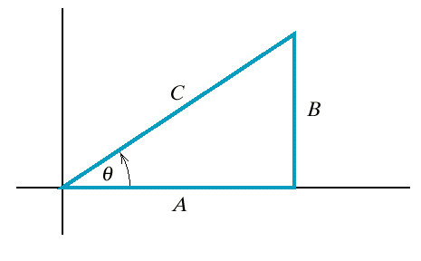
Example
Given a voltage V= Acosωt+Bsin ω t.
Find the voltage in the form of V=C cos (ωt + θ).

Slide 4
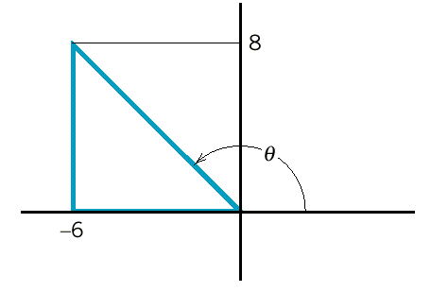
Example
A
B
B
A

Slide 5
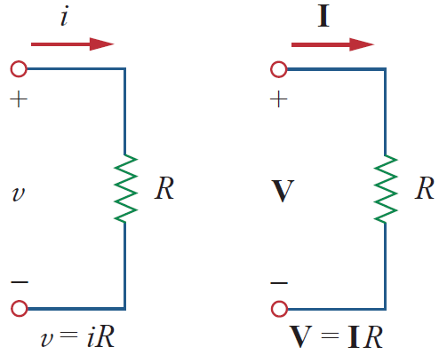





Phasor Relationships for Circuit Elements
Resistor (R)
If the current through a resistor R
voltage across it
Voltage-current relations for a resistor in the: time domain, & frequency domain
The phasor form of this voltage is
Phasor representation of the current is
Hence,

Slide 6
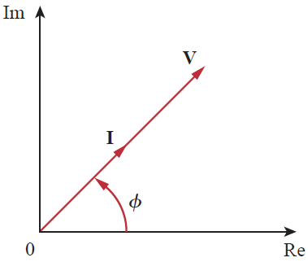
Phasor Relationships for Circuit Elements
Resistor (R)
Voltage and current are in phase, as illustrated in the phasor diagram
Phasor diagram for the resistor.

Slide 7
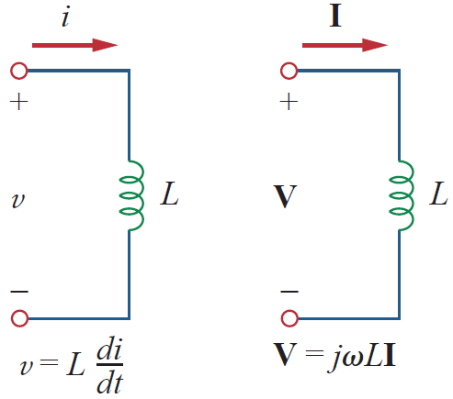
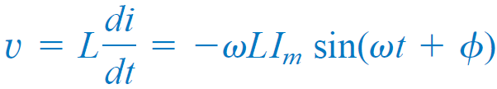

Phasor Relationships for Circuit Elements
Inductor (L)
Assume the current through it is
The voltage across the inductor is
Recall that
which transforms to the phasor

Slide 8
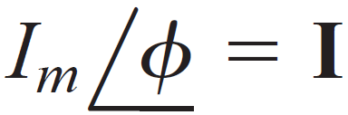
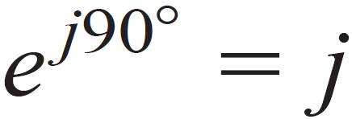

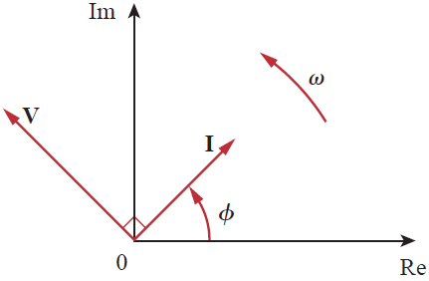
Phasor Relationships for Circuit Elements
Inductor (L)
But
Thus,
The voltage and current are 90º out of phase.
Specifically, the current lags the voltage by 90º.

Slide 9

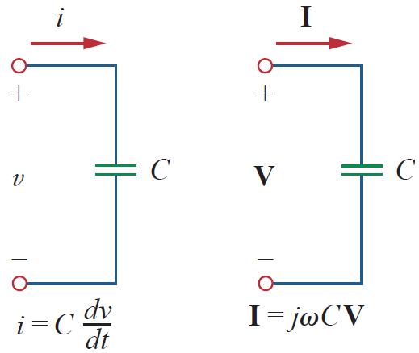
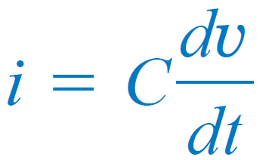
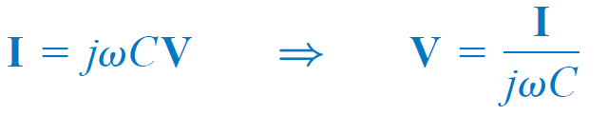
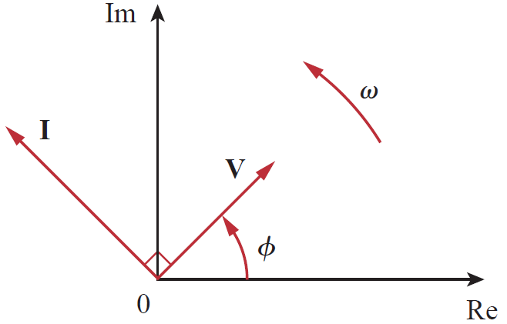
Phasor Relationships for Circuit Elements
Capacitor (C)
The current through the capacitor is
By following the same steps as we took for the inductor
Phasor diagram for the capacitor; I leads V by 90º.

Slide 10
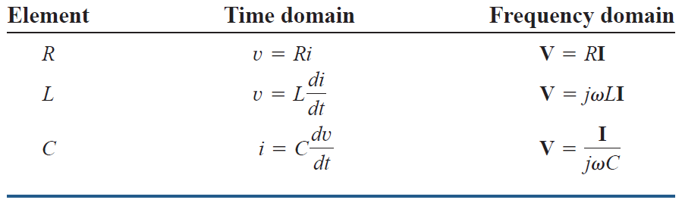
Summary of voltage-current relationships

Slide 11
Example
The voltage v = 12 cos(60t + 45⁰) is applied to a 0.1-H inductor. Find the steady-state current through the inductor.

Slide 12



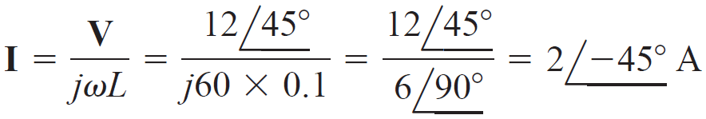
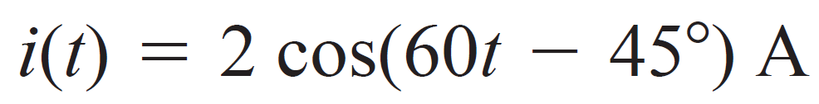
Solution:
For the inductor,
where
and
Hence,
Converting this to the time domain,

Slide 13
References
Charles K. Alexander (Author), Matthew N.O Sadiku, “ Fundamentals of Electric Circuits”, 6th ed, Tata Mc Graw Hill, 2019..
D.C. Kulshreshtha, Basic Electrical Engineering, Revised 1st ed, Tata Mc Graw Hill, 2017.
V. K.Mehta, Rohit Mehta, Basic Electrical Engineering, 6th ed, S. Chand Publishing, 2012.

Slide 14
Thanks

